Slide 1
What is Driving my Fuel Consumption?
Eli Steinbeck
9/8/2021

Slide 2
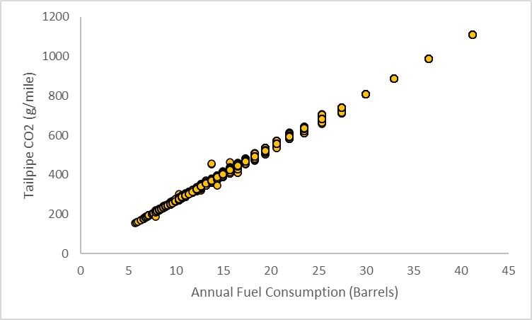
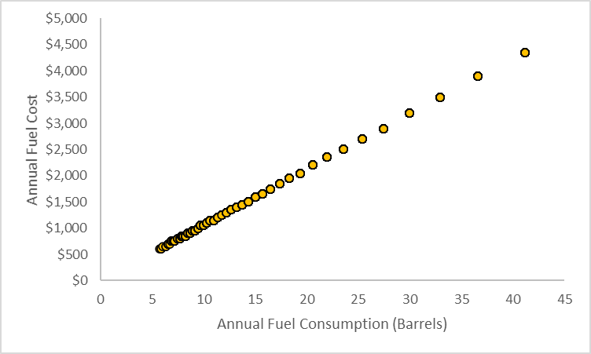
Why Should Anyone Care?
More fuel means higher emissions.
2. More fuel means more money.
Question: What sort of factors have a significant influence on annual fuel consumption?

Slide 3
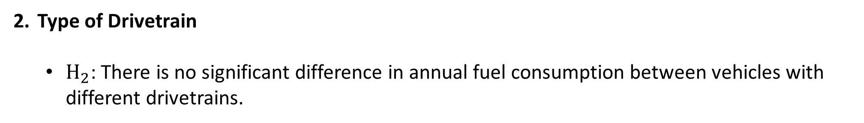
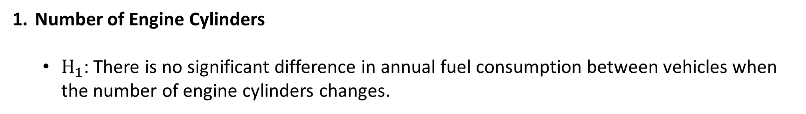
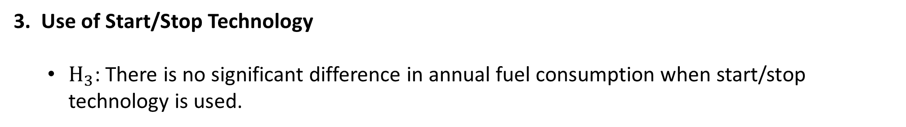
What Are We Testing?
Number of Engine Cylinders
$H_{1}$: There is no significant difference in annual fuel consumption between vehicles when the number of engine cylinders changes.
Type of Drivetrain
$H_{2}$: There is no significant difference in annual fuel consumption between vehicles with different drivetrains.
3. Use of Start/Stop Technology
$H_{3}$: There is no significant difference in annual fuel consumption when start/stop technology is used.

Slide 4
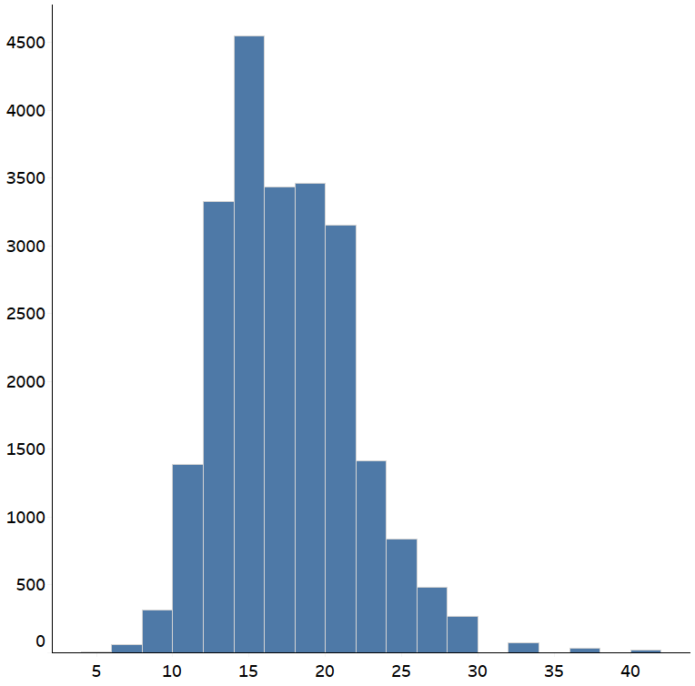
Digging Into the Data
Data is a compilation of EPA fuel economy estimates and comes from Kaggle.
Using independent samples t-test to find evidence of causality.
Annual fuel consumption was chosen as the dependent variable.
Analysis limited to vehicles that run on regular gasoline.
Descriptive Statistics
Mean | 17.59
Standard Error | 0.03
Median | 16.48
Mode | 15.70
Standard Deviation | 4.48
Sample Variance | 20.11
Kurtosis | 1.26
Skewness | 0.82
Range | 35.52
Minimum | 5.68
Maximum | 41.20
Sum | 453989
Count | 25806
Count of Vehicles
Annual Fuel Consumption (Barrels)

Slide 5
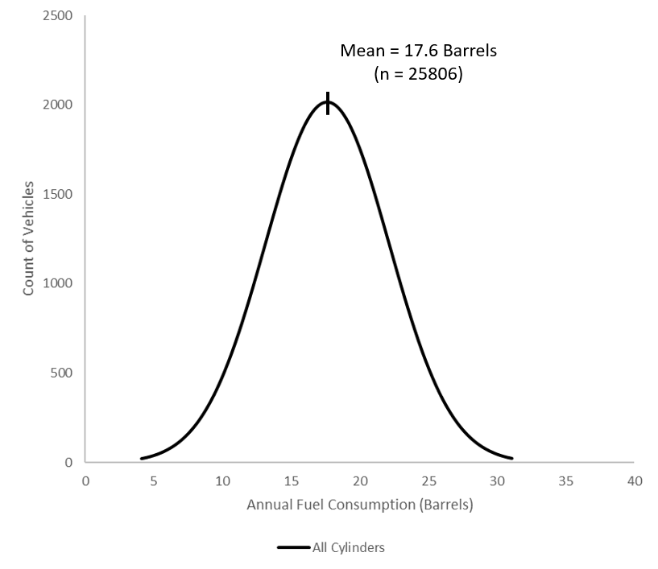
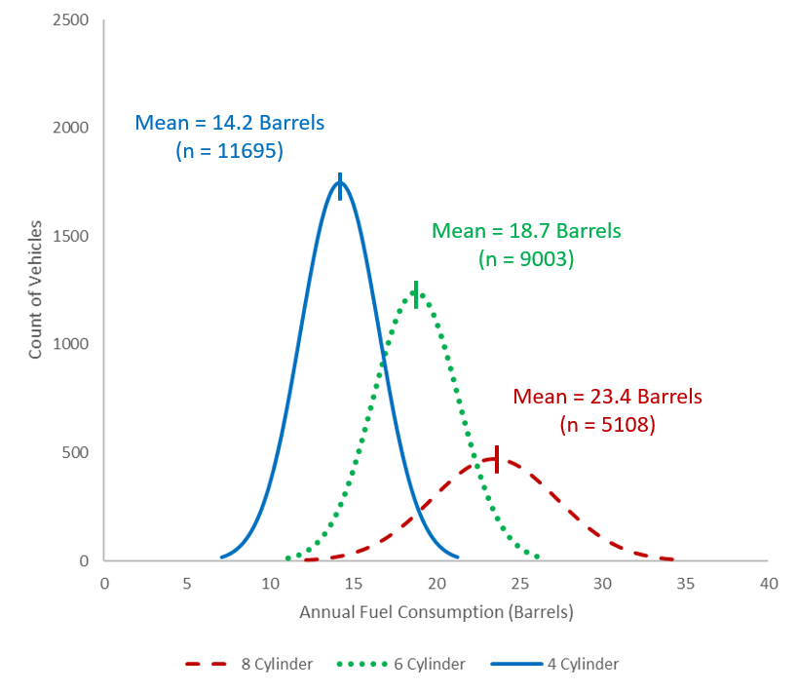
Impact of Number of Engine Cylinders
t-test Results
4 vs 6 Cylinders
6 vs 8 Cylinders
Reject the null
P < .05
95% C.I. = 4.43 – 4.56
Reject the null
P < .05
95% C.I. = 4.62 – 4.85
Difference in Annual Fuel Cost
4 vs 6 Cylinders
6 vs 8 Cylinders
$461 - $475
$481 - $506

Slide 6
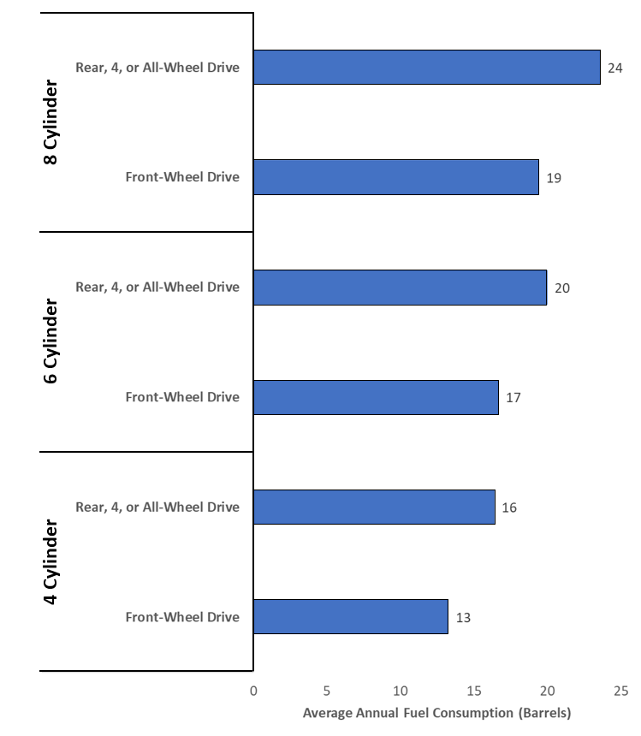
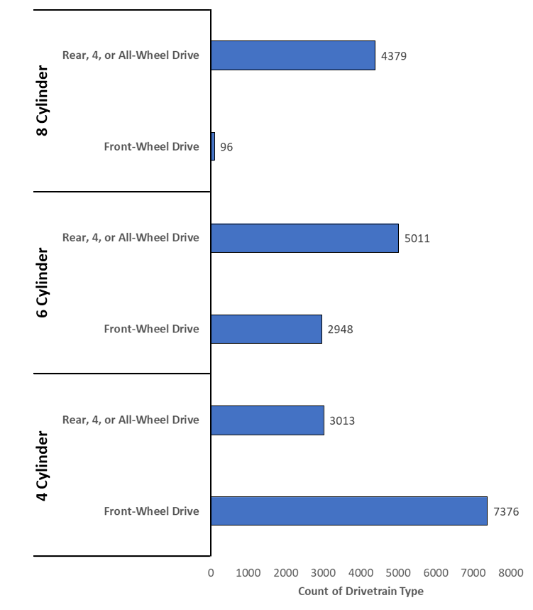
Impact of Drivetrain Type
t-test Results
Difference in Annual Fuel Cost
Reject the null
P < .05
95% C.I. = 3.77 – 4.60
$390 - $479
Reject the null
P < .05
95% C.I. = 3.27 – 3.42
$337 - $353
Reject the null
P < .05
95% C.I. = 3.06 – 3.23
$315 - $333

Slide 7
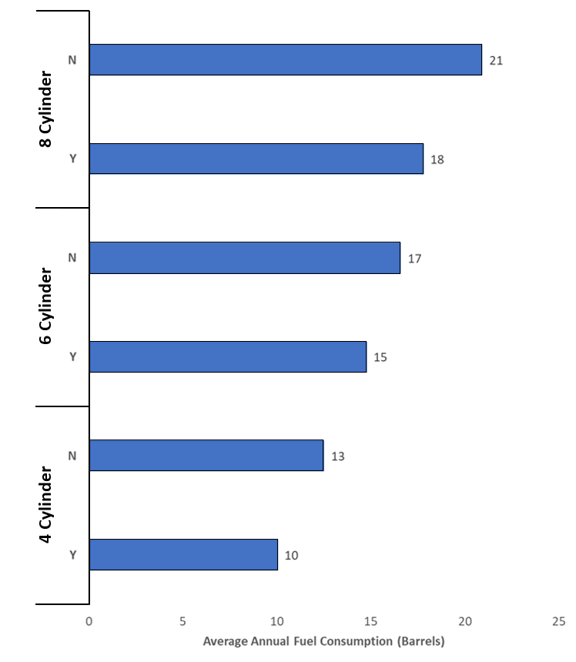
Impact of Using Start/Stop Technology
t-test Results
Difference in Annual Fuel Cost
Reject the null
P < .05
95% C.I. = 2.43 – 3.81
$247 - $395
Reject the null
P < .05
95% C.I. = 1.37 – 2.23
$134 - $226
Reject the null
P < .05
95% C.I. = 2.21 – 2.70
$224 - $276

Slide 8
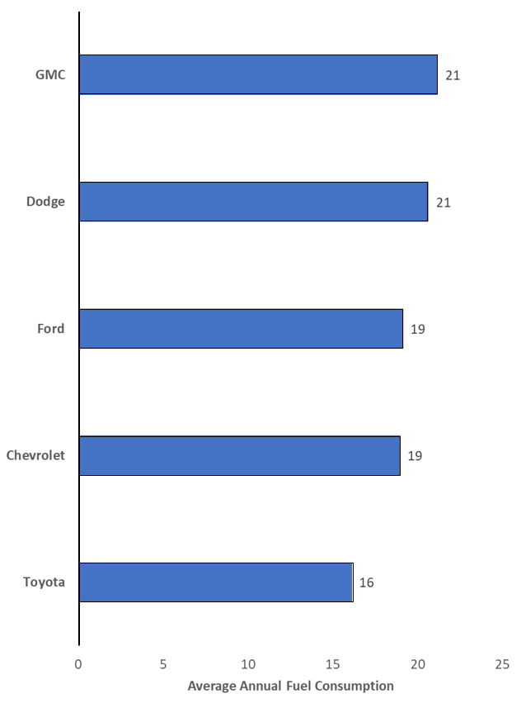
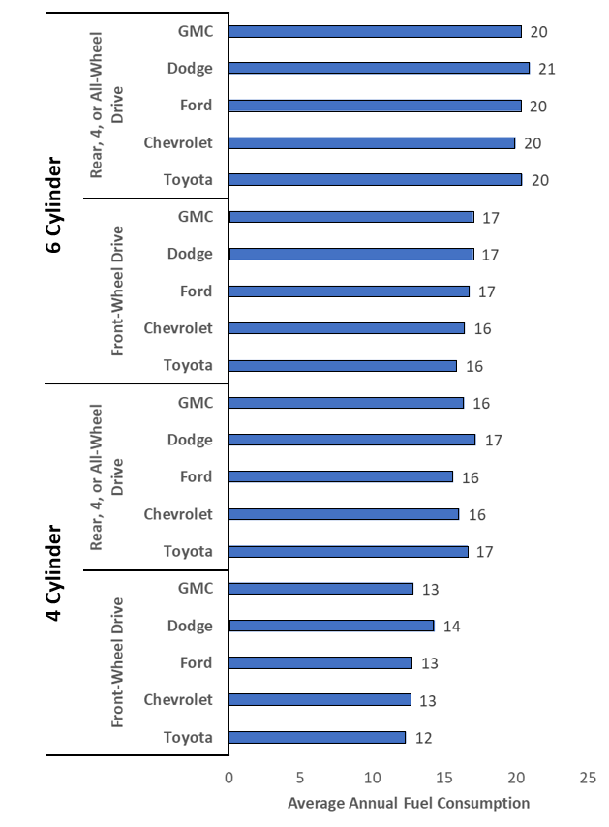
A Note About Bias
Without Categorical Breakdown
With Categorical Breakdown
Vehicle make appears to influence annual fuel consumption.
But is it for the reason we think?
The same data viewed two different ways can tell two different stories.

Slide 9
Takeaways
Number of engine cylinders, type of drive train, and the use of start/stop technology all have a significant impact on annual fuel consumption and resulting annual costs.
Average Cost Savings With:
Smaller Engine
Front-Wheel Drive
Start/Stop Technology
$461 - $986
$315 - $479
$134 - $395
Recommendation: Include a cost saving dashboard tool on the review site that highlights the annual cost savings associated with changing impactful technical specs.
Recommendation for future work: Would extend the analysis even further to understand the impact of vehicle class and fuel type (including electric and hybrid vehicles).

Slide 10
Supplemental Charts

Slide 11
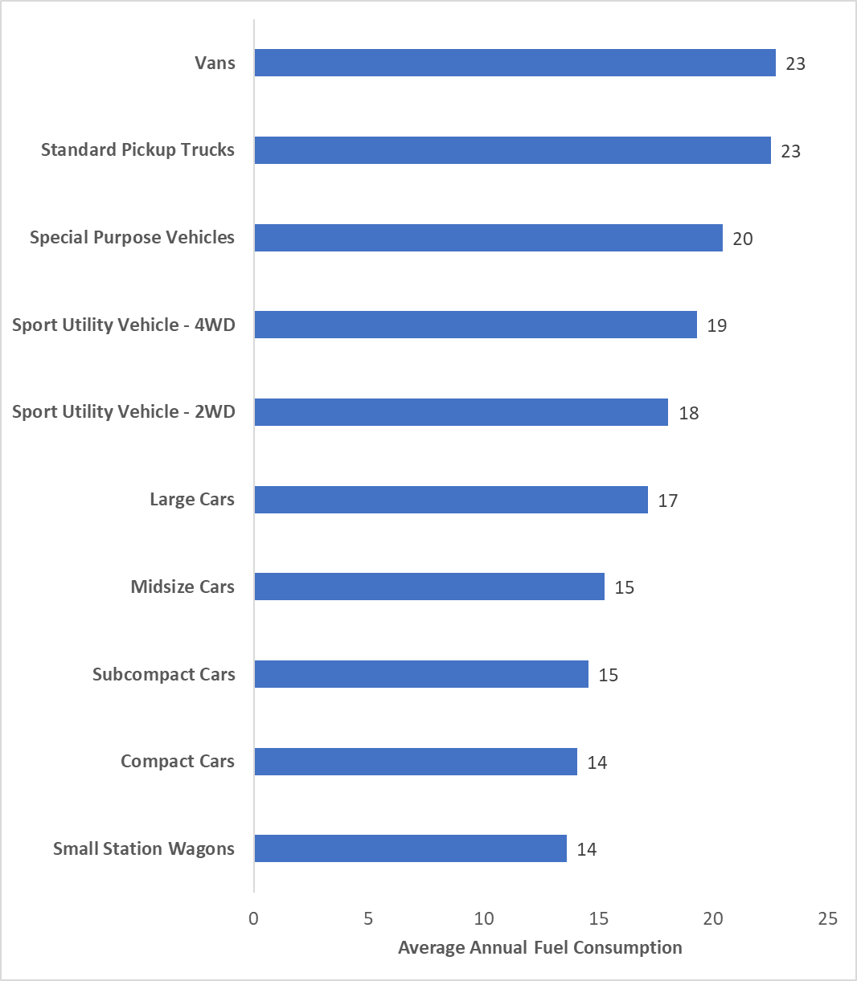
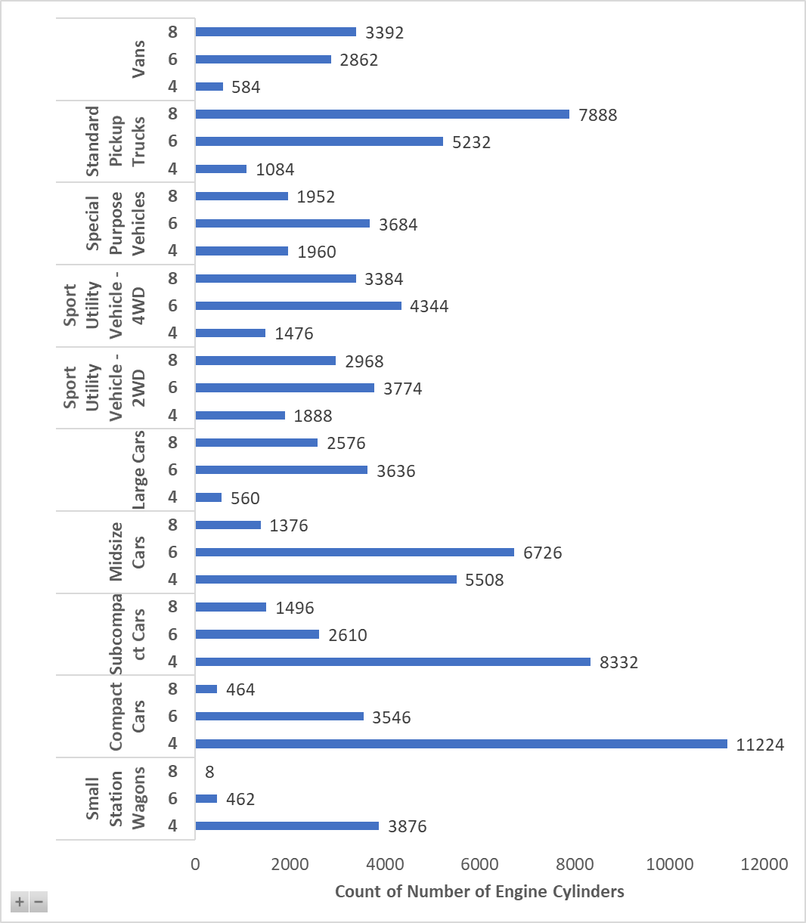
Impact of Vehicle Class

Slide 12
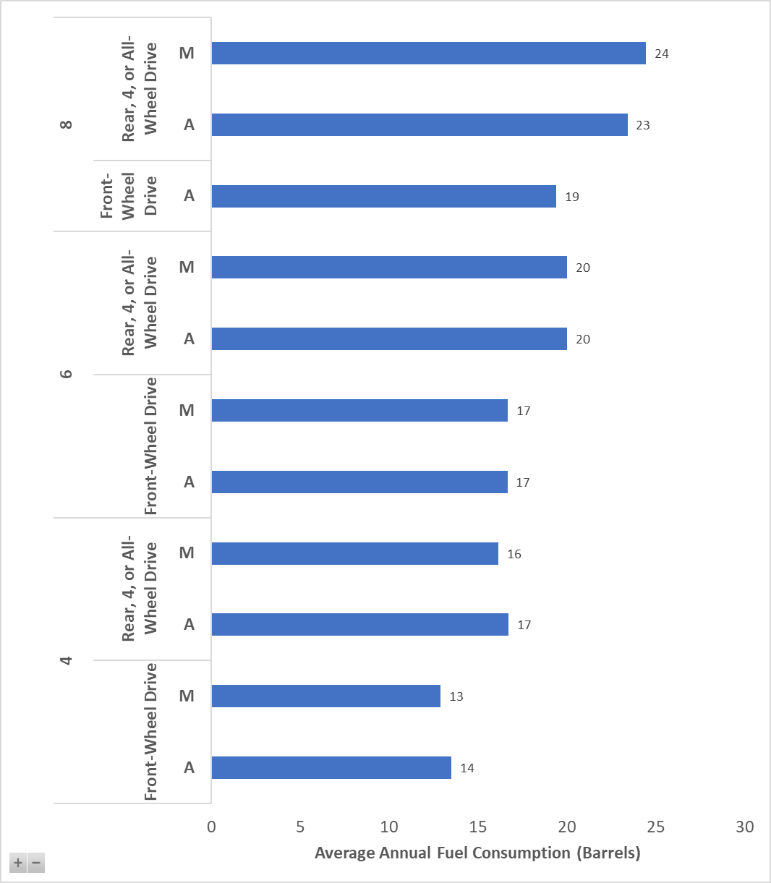
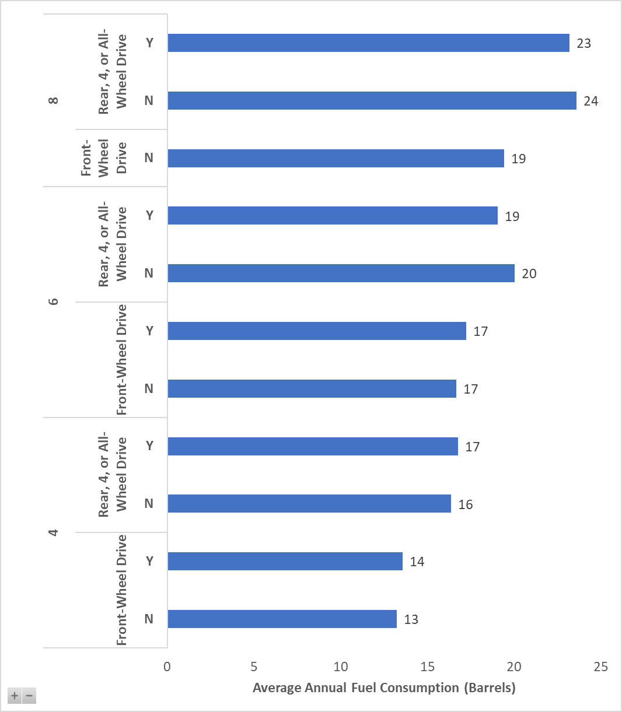
Impact of Transmission
Impact of Using Turbo/Superchargers

Slide 13
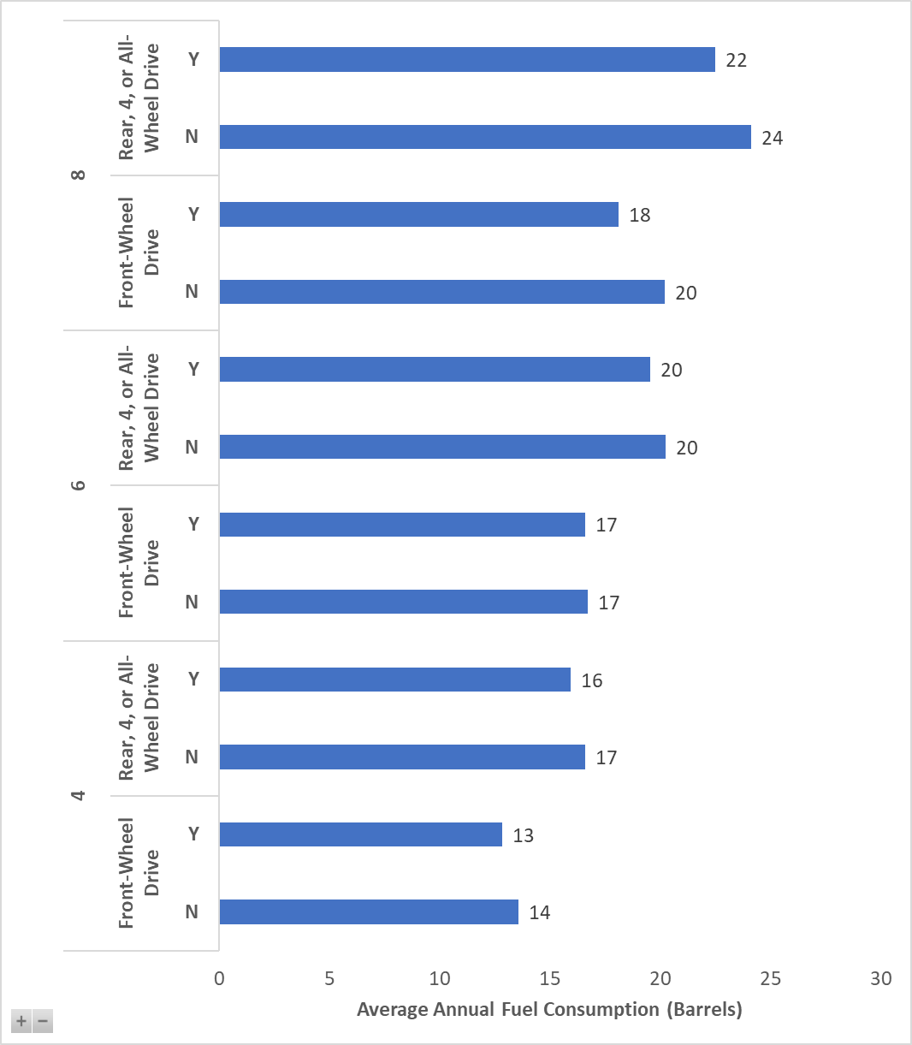
Impact of Using My MPG Data

